Slide 1
Computer Peripherals and Interfacing
Lecture-2
Tumpa Rani Shaha
Assistant Professor, Dept of CSE
BSMRSTU

Slide 2
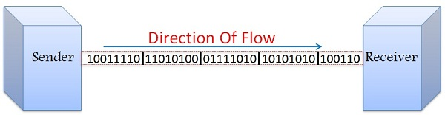
Synchronous Transmission
In Synchronous Transmission, data flows in the form of blocks or frames. Synchronization between the sender and receiver is necessary so that the sender know where the new byte.
Synchronous Transmission is efficient, reliable and is used for transferring a large amount of data. It provides real-time communication between connected devices.
Chat Rooms, Video Conferencing, telephonic conversations, as well as face to face interactions, are some of the examples of Synchronous Transmission.

Slide 3
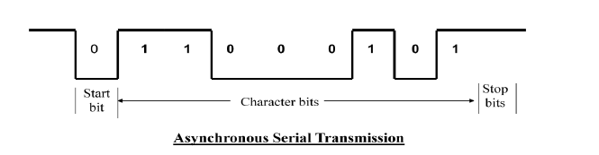
Asynchronous Serial Transmission:
In Asynchronous Transmission, data is sent in form of byte or character. Each character consists of three points
i. Start bit
ii. Character bit
iii. Stop bit

Slide 4
Asynchronous Serial Transmission:
Start Bit- First bit, called start bit is always zero and used to indicate the beginning character.
Stop Bit- Last bit, called stop bit is always one and used to indicate end of characters.
Character Bit- Bits in between the start bit and the stop bit are known as character bits. The character bits always follow the start bit.

Slide 5
Modes of Data Transfer :
The data transfer can be handled by 3 following ways:
Programmed I/O
Interrupt-Initiated I/O
Direct Memory Access (DMA)
Data transfer between the CPU and the peripherals is initiated by the CPU. But the CPU cannot start the transfer unless the peripheral is ready to communicate with the CPU.

Slide 6
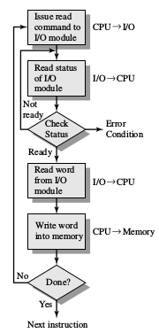
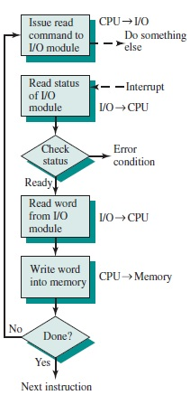
Programmed I/O
Interrupt Driven I/O

Slide 7
Programmed I/O
Programmed I/O (PIO) refers to data transfers initiated by a CPU under driver software control to access registers or memory on a device
The CPU issues a command then waits for I/O operations to be complete. As the CPU is faster than the I/O module, the problem with programmed I/O is that the CPU has to wait a long time for the I/O module of concern to be ready for either reception or transmission of data. The CPU, while waiting, must repeatedly check the status of the I/O module, and this process is known as Polling. As a result, the level of the performance of the entire system is severely degraded.

Slide 9
Programmed I/O
Programmed I/O basically works in these ways:
CPU requests I/O operation
I/O module performs operation
I/O module sets status bits
CPU checks status bits periodically
I/O module does not inform CPU directly
I/O module does not interrupt CPU
CPU may wait or come back later

Slide 10
Drawback of the Programmed I/O :
The main drawback of the Program Initiated I/O was that the CPU has to monitor the units all the times when the program is executing. Thus the CPU stays in a program loop until the I/O unit indicates that it is ready for data transfer. This is a time consuming process and the CPU time is wasted a lot in keeping an eye to the executing of program.
To remove this problem an Interrupt facility and special commands are used.

Slide 11
Interrupt-Initiated I/O :
Data transfer between the CPU and the peripherals is initiated by the CPU. But the CPU cannot start the transfer unless the peripheral is ready to communicate with the CPU. When a device is ready to communicate with the CPU, it generates an interrupt signal. A number of input-output devices are attached to the computer and each device is able to generate an interrupt request.
The main job of the interrupt system is to identify the source of the interrupt. There is also a possibility that several devices will request simultaneously for CPU communication. Then, the interrupt system has to decide which device is to be serviced first.

Slide 13
Priority Interrupt:
There are number of IO devices attached to the computer. They are all capable of generating the interrupt.
When the interrupt is generated from more than one device, priority interrupt system is used to determine which device is to be serviced first.
Devices with high speed transfer are given higher priority and slow devices are given lower priority.

Slide 14
Serial or Daisy Chaining Priority:
Device with highest priority is placed first.
Device that wants the attention send the interrupt request to the CPU.
CPU then sends the INTACK signal which is applied to PI(priority in) of the first device.
If it had requested the attention, it place its VAD(vector address) on the bus. And it block the signal by placing 0 in PO(priority out)
If not it pass the signal to next device through PO(priority out) by placing 1.

Slide 15
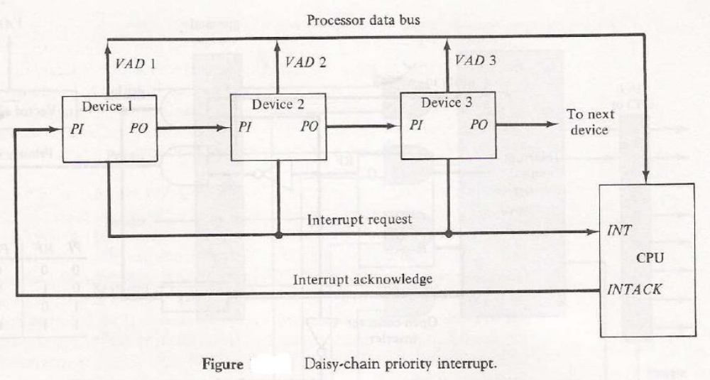
Serial or Daisy Chaining Priority:
This process is continued until appropriate device is found.
The device whose PI is 1 and PO is 0 is the device that send the interrupt request.

Slide 16
Direct Memory Access (DMA)
Direct Memory Access (DMA) means CPU grants I/O module authority to read from or write to memory without involvement.
DMA module controls exchange of data between main memory and the I/O device.
Because of DMA device can transfer data directly to and from memory, rather than using the CPU as an intermediary, and can thus relieve congestion on the bus. CPU is only involved at the beginning and end of the transfer and interrupted only after entire block has been transferred.

Slide 17
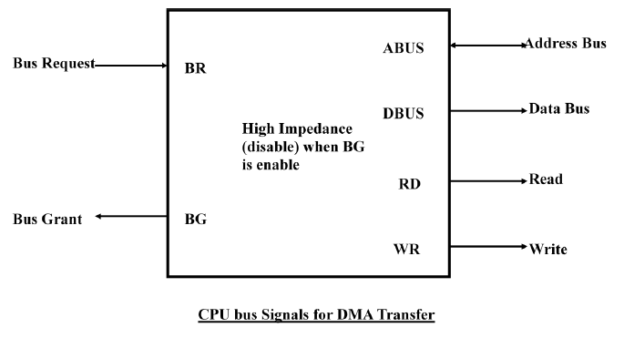

Slide 18
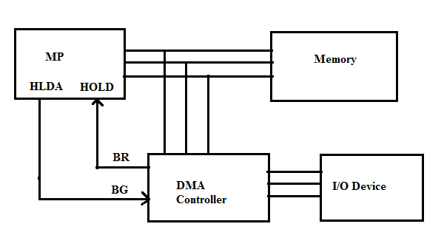
DMA Operation

Slide 19
These two control signals in the CPU that facilitates the DMA transfer.
The Bus Request(BR) input is used by the DMA controller to request the CPU. When this input is active, the CPU terminates the execution of the current instruction and places the address bus, data bus and read write lines into a high Impedance state.
High Impedance state means that the output is disconnected.

Slide 20
The CPU activates the Bus Grant (BG) output to inform the external DMA that the Bus Request (BR) can now take control of the buses to conduct memory transfer without processor.
When the DMA terminates the transfer, it disables the Bus Request (BR) line. The CPU disables the Bus Grant (BG), takes control of the buses and return to its normal operation.

Slide 21
Important controller
8257 DMA controller
8259A Programmable Interrupt Controller
8255A Programmable Peripheral Interface
8254 PROGRAMMABLE INTERVAL TIMER

